Slide 1
Fishbone Diagram Example
https://www.shutterstock.com

Slide 2
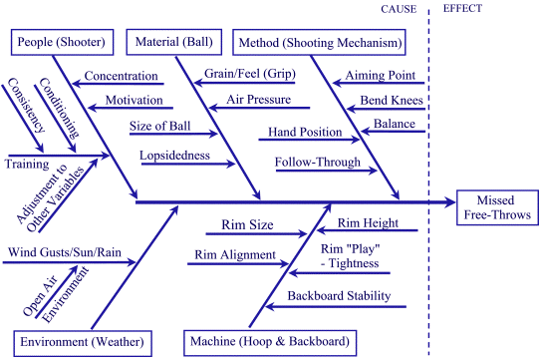
Fishbone Diagram Example
https://media.moresteam.com/main/pics/fish3.gif

Slide 3
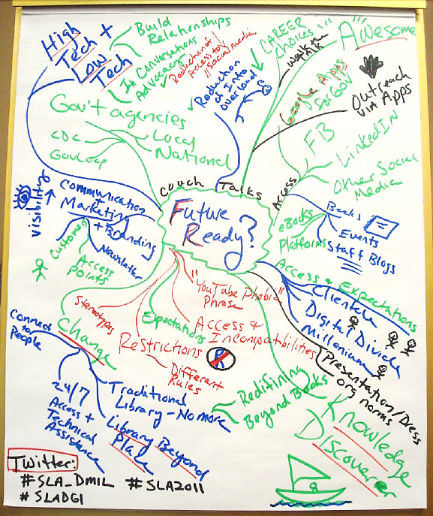
Mind Map Example
http://www.governmentinfopro.com/.a/6a00d834526e2569e2014e8a030f00970d-pi

Slide 4
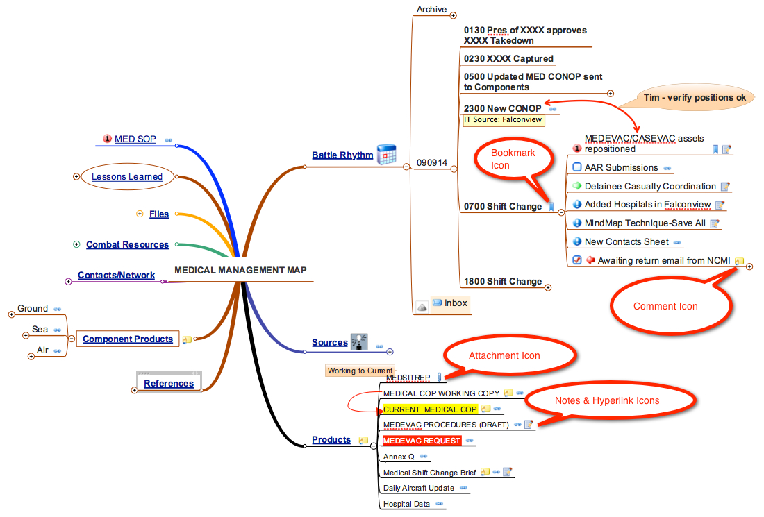
Mind Map Example https://sstrategies.files.wordpress.com/2011/05/battlemanagement-example.jpg

Slide 5
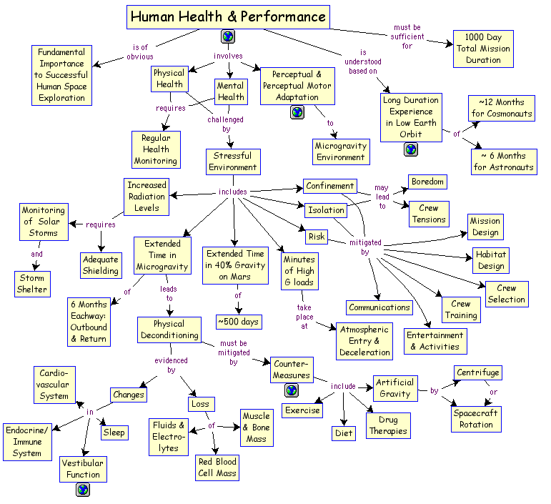
Concept Map Example
https://l00109363.files.wordpress.com/2014/02/human20health2020perf1.gif

Slide 6
Concept Map Example
http://cmapspublic3.ihmc.us/rid=1LQ5FZ3DN-15BXK3S-1DRN/Concept%20Map%20Version%201.cmap?rid=1LQ5FZ3DN-15BXK3S-1DRN&partName=htmljpeg

