Slide 1




Enhancing Strategic Thinking
Skill Building Exercises
Supporting slides

Slide 2
NOTE TO FACILITATORS
The slides in this deck have been developed to provide the following to participants:
Context for the skill-building exercise – including the importance of practicing foundational skills to become an effective strategic thinker
An overview of the exercise – including the purpose, activities, and learning objectives
Brief tutorial facilitators may choose to adapt, add to, or re-arrange any portions of this slide deck to introduce the exercise to participants.
Slides contained in the “Background and Context” portion of the slide deck (slides 3 – 10) appear in the slide decks for each of the four exercises.

Slide 3
Background and Context

Slide 4
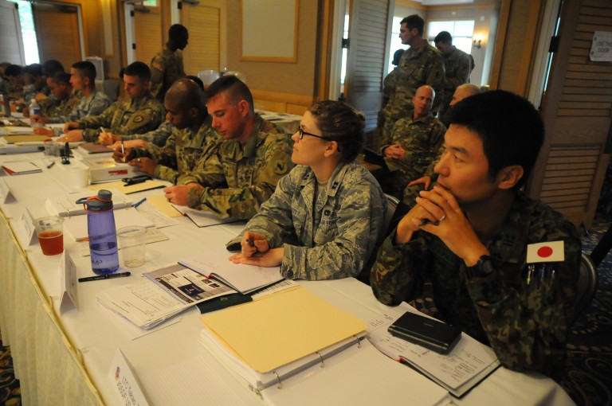
CURRENT AND FUTURE ARMY LEADERS NEED TO BE ABLE TO THINK STRATEGICALLY
Army leaders need to anticipate change, think long term, envision potential futures, and exploit opportunities to serve national interests
Before Army leaders step into positions that require them to function as strategic thinkers and planners, they need to hone the “building block” skills that underpin strategic thinking
Image credit: http://www.hawaiiarmyweekly.com/storage/2016/02/2378779-768x510.jpg

Slide 5
WHAT SKILLS ARE FOUNDATIONAL TO STRATEGIC THINKING ABILITY?
Competency | A Strategic Thinker…
Comprehensive Information Gathering | continuously scans the environment seeks information from disparate sources suspends judgment and maintains an open mind considers other perspectives possesses advanced listening and research skills
Learning | is a lifelong learner iteratively tests, reflects on, conceptualizes, and manages knowledge to gain insights on the environment continuously examines his/her own thinking
Critical Thinking | identifies the essential aspects of a situation questions assumptions and asks relevant questions seeks to identify meaningful connections and distinctions understands nuance considers the limits of data

Slide 6
WHAT SKILLS ARE FOUNDATIONAL TO STRATEGIC THINKING ABILITY? (Cont’d.)
Competency | A Strategic Thinker…
Thinking in Time | understands historical and contemporary contexts. recognizes patterns. forecasts possible futures. anticipates second-and third-order effects. has a long-term perspective.
Innovative Thinking | generates creative and novel ideas, concepts, and approaches, independent of conventional norms.
Systems Thinking | uses a holistic perspective of the dynamic and complex environment. identifies interrelationships and integrates disparate factors into a comprehensive whole.

Slide 7
WHAT ELSE IS IMPORTANT TO STRATEGIC THINKING ABILITY?
Competency | A Strategic Thinker…
Knowledge | Has a solid foundation for strategic thinking based in: a broad general knowledge of many disciplines (e.g., geo-politics, world religions/cultures, economics, technology, sociology). knowledge specific to a strategic environment (e.g., local/regional customs, history, stakeholders).
Collaboration | Leverages the capabilities of others in a team or informal network (e.g., through cooperation, leadership, building trust, conflict management) to supplement his/her own strategic thinking.
Communication | Communicates candidly and effectively to gain individual understanding and move to the shared understanding required for strategy implementation. Is adept in the use of multiple media formats (oral, written, visual). Communicates well with diverse audiences that require tailored and persuasive messages.
Emotional Regulation | Is intellectually humble. Accounts for his/her own natural limitations and biases related to emotion, perspective, and self-interest. Maintains respect for differing values and priorities.

Slide 8
STRATEGIC THINKING SKILL-BUILDING EXERCISES WILL HELP YOU BUILD SKILLS NEEDED FOR STRATEGIC THINKING.
Exercises in this series include:
Reflecting on Experience--provides practice in reflective thinking, learning from experience.
Asking Powerful Questions--provides practice in questioning.
Telling a Story--provides practice in systems thinking, synthesis.
Envisioning Potential Futures–-provides practice in thinking in time, strategic foresight.

Slide 9

THINK OF THESE EXERCISES AS COMPARABLE TO AN ATHLETIC DRILL.
Professional basketball players don’t just play a lot of basketball.
They practice component skills –ball handling, shooting baskets, rebounding, and footwork.
Practicing these foundational skills –repeatedly and over time –is essential to becoming a skilled basketball player.
Image credit: shutterstock.com
Notes:
Athletic Skill analogy – One way to think about these exercises is akin to what young athletes experience on their way to becoming exceptional athletes. A basketball player practices component skills such as dribbling, shooting, rebounding, and passing. Practicing these component skills – and doing so repeatedly and over time – is essential to becoming a skilled basketball player.

Slide 10

DEVELOPING STRATEGIC THINKING ABILITY ALSO REQUIRES TIME, PRACTICE, AND ATTENTION TO FOUNDATIONAL SKILLS.
Doing any of the exercises once or twice will not transform you into a strategic thinker.
They are analogous to the drills that athletes use to hone their skills.
Developing advanced ST skills means repeatedly practicing the foundational skills necessary to become a great strategic thinker.
The exercises can help you practice some of the (many) skills you’ll need in order to become a skilled strategic thinker.
Image credit: shutterstock.com
Notes:
In the same way, practicing skills such as reflecting, questioning, systems thinking, and thinking into the future (and doing so repeatedly) is essential to becoming a skilled strategic thinker.
Doing any of the exercises once or twice will not transform you into a strategic thinker.
They are analogous to the drills that athletes use to hone their skills.
Developing advanced strategic thinking skills means repeatedly practicing the foundational skills necessary to become a great strategic thinker.
The exercises can help you practice some of the (many) skills you’ll need in order to become a skilled strategic thinker.

Slide 11
Overview
Telling A Story: An Exercise in Connecting the Dots

Slide 12

WHAT’S THE PURPOSE OF THIS EXERCISE?
Primary Purpose: To build your systems thinking and synthesis skills.
  Systems thinking – Identifying and accounting for relationships and interdependencies among factors that might appear to be unrelated.
  Synthesis – Integrating information into a coherent whole.
Secondary Purpose: To provide practice in adapting your thinking in the face of new information.
Image credit: shutterstock.com
Notes:
Facilitator notes:
Part of thinking strategically involves the ability to identify connections that might not be readily apparent. In operational settings, we often encounter data that seems like a jumble, and we need to figure out some way to make sense out of what’s there.
Before we begin, I’d like to emphasize that what we are doing today is not about learning new concepts or making sure you can define what systems thinking is, but practicing a skill that is important for strategic thinking.
This exercise, by itself, is not going to transform you into an expert strategic thinker. Developing the ability to think strategically takes a considerable amount of time, relevant experiences, understanding of key concepts, and a lot of practice.
Describe connection to exercise – What we’re doing today is a drill to help you practice connecting the dots, that is systems thinking and synthesis – two (of the many) skills you’ll need to become a powerful strategic thinker.

Slide 13
THE EXERCISE WILL ALSO HELP YOU PRACTICE THESE ADDITIONAL SKILLS:
Hypothesis generation – Creating potential explanations, given a set of information.
Cognitive flexibility – Adapting your perspective, assumptions, thought process and/or interpretations.
Sensegiving – Communicating your understanding to others.

Slide 14
WHAT WILL I DO IN THE EXERCISE?
View a set of images, and develop a story that accounts for the information contained in the set of images
Present your story to others in your group
Revise your story (or create a new one) based on new images
Reflect on the exercise; discuss as a group

Slide 15

WHAT MATERIALS DO I NEED?
Participant Guide (provided by facilitator)
Images (provided by facilitator)
Pen/pencil
Notebook/pad of paper
Image credit: shutterstock.com

Slide 16
WHAT WILL I GAIN FROM THIS EXERCISE?
Appreciate the importance of recognizing connections across seemingly unrelated factors
Recognize that factors that might seem unrelated on a superficial level, may actually interact in ways that need to be understood
Demonstrate an ability to integrate multiple elements into a coherent whole.
Demonstrate ease in adapting your explanation when new or different information is introduced.
Notes:
By the end of the exercise, you should be able to:
Appreciate the importance of recognizing connections across seemingly unrelated factors in order to understand a complex problem or set of circumstances.
Recognize that factors that might seem unrelated on a superficial level, may actually interact in ways that need to be understood in order to anticipate and/or shape future circumstances.
Demonstrate an ability to integrate multiple elements into a coherent whole.
Demonstrate ease in adapting your explanation when new or different information is introduced.

Slide 17
Brief Tutorial

Slide 18
“CONNECTING THE DOTS” REQUIRES TWO CLOSELY-RELATED SKILLS: SYSTEMS THINKING AND SYNTHESIS.
Systems thinking
  A way to recognize and account for relationships and interactions among people, events, regions, and other components of a system.
  Allows us to comprehend and appreciate the “bigger picture”.
Synthesis
  The process of bringing together disparate data elements (information, opinions, perspectives) and integrating them into a coherent whole.
Notes:
Today, we are going to conduct an exercise in using two closely-related skills that are important to our ability to think strategically: synthesis and systems thinking. Synthesis is the ability to identify connections across seemingly unrelated pieces of information, such as opinions, perspectives, or data, and to bring the pieces together into a cohesive whole. Systems (or holistic) thinking is the ability to recognize and account for relationships and interactions among people, events, regions, and other components of a system.
These skills allow us to “connect the dots” or think holistically about elements and pieces of information, in order to understand a bigger picture. Synthesis and systems thinking also allow us to develop a fuller and more coherent appreciation of a problem, which can support our ability to envision the future, and the actions that are most appropriate for shaping it. Effective synthesis and systems thinking skills also help us organize large amounts of data into categories and concepts, making it easier to identify important connections.

Slide 19
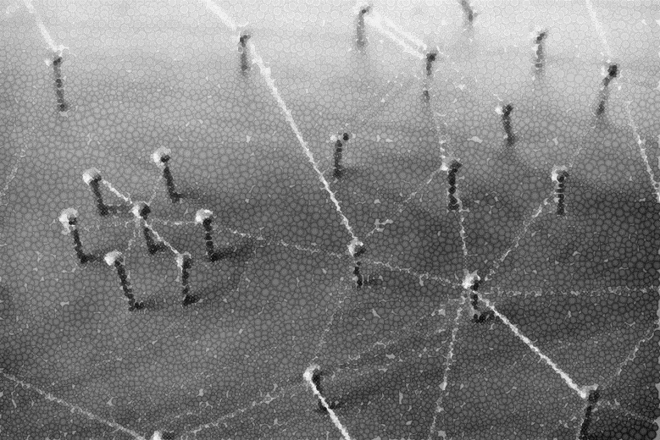
HOW DO SYSTEMS THINKING AND SYNTHESIS MATTER FOR STRATEGIC THINKING?
Events, people, circumstances, and information that seem unrelated on the surface may actually be related.
    Understanding those connections lets us effectively anticipate and shape future situations.
Systems thinking and synthesis allow us to recognize and describe a bigger picture, and to think holistically about a problem or situation.
A fuller appreciation of a problem or situation helps to inform the decisions we make to shape the future.
Image credit: shutterstock.com

Slide 20
WHAT’S HARD? Challenges to Synthesis and Systems Thinking
Many of us tend to use analytic approaches to thinking (i.e., understanding pieces and parts).
  Can lead us to miss important connections critical to understanding
Recognizing and appreciating connections takes time.
We often focus on surface features and may miss fundamental underlying issues.
Operational settings are dynamic; making sense of situations is tough when new data are continually being added
Notes:
There are multiple challenges or barriers to practicing synthesis and systems thinking. Some examples include:
Most of us tend to use analytic approaches to thinking (i.e., understanding pieces and parts), as opposed to recognizing connections among data and how they fit together. While an analytical approach is important and necessary, it can be counter-productive in the context of strategic thinking and thinking about complex problems, when used in isolation. Analytical thinking by itself can lead us to miss important connections that are critical to understanding and shaping the future. When thinking only analytically, we are also more likely to address the wrong problem, or not solve the real issues.
Recognizing and appreciating connections takes time. In the rush to move to solutions, we may minimize the importance of systems thinking and synthesis, or skip them altogether.
We often focus on surface features and the most obvious commonalities, as that information is most salient. However, digging deeper to search for nuances and more subtle connections may reveal a different picture. Solutions we generate based on surface features may be short-term-oriented and/or
lack the ability to address fundamental underlying issues.
We tend to search for “the answer” rather than “an answer.” Identifying connections across data and factors and determining what those connections mean, provides a way to develop hypotheses (premises) about what might be happening, why, and what the implications might be.
Operational settings are dynamic in nature and it is particularly challenging to make sense of current
data when new data are continually being added. One pitfall is to stick with one interpretation, even if new data suggests revising the interpretation. Learning how to flex one’s thinking is key to synthesis and systems thinking.

Slide 21
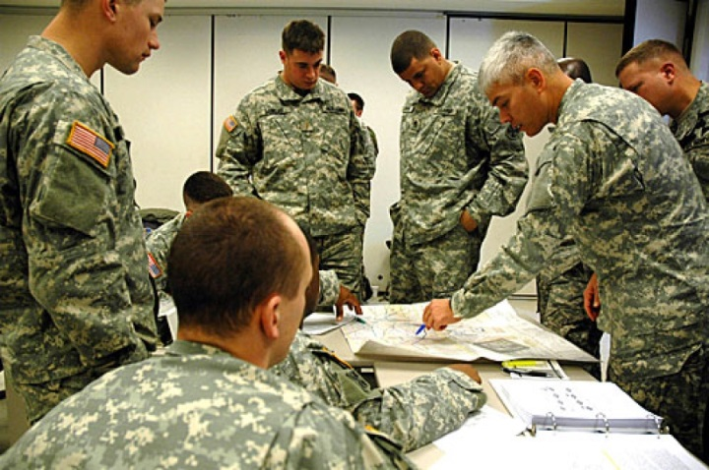
TIPS FOR RECOGNIZING CONNECTIONS AND INTEGRATING DISPARATE INFORMATION
Consider a range of factors in addition to those that are immediately apparent – for example, politics, economics, social structures, and cultural norms.
Consider inter-relationships and interactions among elements.
Image credit:: Stars and Stripes.com
Create a sketch, graphic, or concept map that shows connections and interactions among elements.
Describe the “big picture” you are seeing to others, and seek their feedback.
Notes:
The material on this service may not be reproduced for any commercial purpose with out the express written consent of Stars and Stripes. For permission to reprint S&S material please write or e-mail to:
Stars and Stripes, Central Office
Attn: Reprint Permissions
529 14th St., NW, Suite 350
Washington, DC 20045-1301
Phone: (202) 761-0900
Fax: (202) 761-0890
E-mail:permission@stripes.osd.mil
* Please describe the material (story, photo, etc.) to be used, the purpose of the republication and the manner of use. Please include mailing & e-mail addresses, and a phone number.

