Slide 1
Enhancing Strategic Thinking Skill Building Exercises
Supporting slides

Slide 2
NOTE TO FACILITATORS
The slides in this deck have been developed to provide the following to participants:
Context for the skill-building exercise – including the importance of practicing foundational skills to become an effective strategic thinker
An overview of the exercise – including the purpose, activities, and learning objectives
Brief tutorial facilitators may choose to adapt, add to, or re-arrange any portions of this slide deck to introduce the exercise to participants.
Slides contained in the “Background and Context” portion of the slide deck (slides 3 – 10) appear in the slide decks for each of the four exercises.

Slide 3
Background and Context

Slide 4
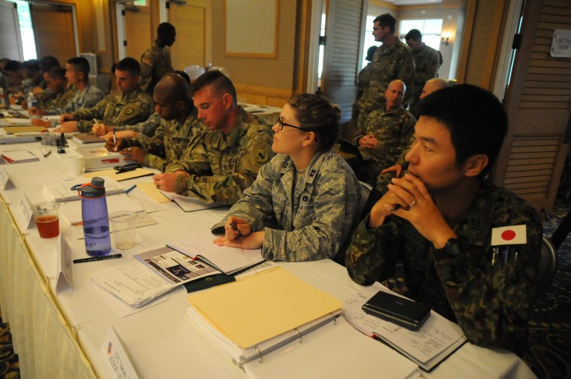
CURRENT AND FUTURE ARMY LEADERS NEED TO BE ABLE TO THINK STRATEGICALLY
• Army leaders need to anticipate change, think long term, envision potential futures, and exploit opportunities to serve national interests
• Before Army leaders step into positions that require them to function as strategic thinkers and planners, they need to hone the “building block” skills that underpin strategic thinking
Image credit: http://www.hawaiiarmyweekly.com/storage/2016/02/2378779-768x510.jpg

Slide 5
WHAT SKILLS ARE FOUNDATIONAL TO STRATEGIC THINKING ABILITY?
Competency | A Strategic Thinker…
Comprehensive Information Gathering | continuously scans the environment seeks information from disparate sources suspends judgment and maintains an open mind considers other perspectives possesses advanced listening and research skills
Learning | is a lifelong learner iteratively tests, reflects on, conceptualizes, and manages knowledge to gain insights on the environment continuously examines his/her own thinking
Critical Thinking | identifies the essential aspects of a situation questions assumptions and asks relevant questions seeks to identify meaningful connections and distinctions understands nuance considers the limits of data

Slide 6
WHAT SKILLS ARE FOUNDATIONAL TO STRATEGIC THINKING ABILITY? (CONT’D.)
Competency | A Strategic Thinker…
Thinking in Time | understands historical and contemporary contexts. recognizes patterns. forecasts possible futures. anticipates second-and third-order effects. has a long-term perspective.
Innovative Thinking | generates creative and novel ideas, concepts, and approaches, independent of conventional norms.
Systems Thinking | uses a holistic perspective of the dynamic and complex environment. identifies interrelationships and integrates disparate factors into a comprehensive whole.

Slide 7
WHAT ELSE IS IMPORTANT TO STRATEGIC THINKING ABILITY?
Competency | A Strategic Thinker…
Knowledge | Has a solid foundation for strategic thinking based in: a broad general knowledge of many disciplines (e.g., geo-politics, world religions/cultures, economics, technology, sociology). knowledge specific to a strategic environment (e.g., local/regional customs, history, stakeholders).
Collaboration | Leverages the capabilities of others in a team or informal network (e.g., through cooperation, leadership, building trust, conflict management) to supplement his/her own strategic thinking.
Communication | Communicates candidly and effectively to gain individual understanding and move to the shared understanding required for strategy implementation. Is adept in the use of multiple media formats (oral, written, visual). Communicates well with diverse audiences that require tailored and persuasive messages.
Emotional Regulation | Is intellectually humble. Accounts for his/her own natural limitations and biases related to emotion, perspective, and self-interest. Maintains respect for differing values and priorities.

Slide 8
STRATEGIC THINKING SKILL-BUILDING EXERCISES WILL HELP YOU BUILD SKILLS NEEDED FOR STRATEGIC THINKING.
Exercises in this series include:
Reflecting on Experience--provides practice in reflective thinking, learning from experience.
Asking Powerful Questions--provides practice in questioning.
Telling a Story--provides practice in systems thinking, synthesis.
Envisioning Potential Futures–-provides practice in thinking in time, strategic foresight.

Slide 9
THINK OF THESE EXERCISES AS COMPARABLE TO AN ATHLETIC DRILL.
Professional basketball players don’t just play a lot of basketball.
They practice component skills –ball handling, shooting baskets, rebounding, and footwork.
Practicing these foundational skills –repeatedly and over time –is essential to becoming a skilled basketball player.
Image credit: shutterstock.com
Notes:
Athletic Skill analogy – One way to think about these exercises is akin to what young athletes experience on their way to becoming exceptional athletes. A basketball player practices component skills such as dribbling, shooting, rebounding, and passing. Practicing these component skills – and doing so repeatedly and over time – is essential to becoming a skilled basketball player.

Slide 10
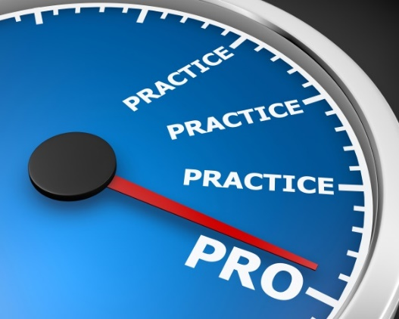
DEVELOPING STRATEGIC THINKING ABILITY ALSO REQUIRES TIME, PRACTICE, AND ATTENTION TO FOUNDATIONAL SKILLS.
Doing any of the exercises once or twice will not transform you into a strategic thinker.
They are analogous to the drills that athletes use to hone their skills.
Developing advanced ST skills means repeatedly practicing the foundational skills necessary to become a great strategic thinker.
The exercises can help you practice some of the (many) skills you’ll need in order to become a skilled strategic thinker.
Image credit: shutterstock.com
Notes:
In the same way, practicing skills such as reflecting, questioning, systems thinking, and thinking into the future (and doing so repeatedly) is essential to becoming a skilled strategic thinker.
Doing any of the exercises once or twice will not transform you into a strategic thinker.
They are analogous to the drills that athletes use to hone their skills.
Developing advanced strategic thinking skills means repeatedly practicing the foundational skills necessary to become a great strategic thinker.
The exercises can help you practice some of the (many) skills you’ll need in order to become a skilled strategic thinker.

Slide 11
Overview
Reflecting on Experience

Slide 12
WHAT’S THE PURPOSE OF THIS EXERCISE?
Primary Purpose: To practice using reflection to promote continuous learning.
Reflective Thinking –The process of “stepping back” from a situation to think critically and deeply about the experience.
Thinking critically before, during, and after an event provides an opportunity to develop greater understanding of both the self and the situation and inform future encounters with similar situations.
Secondary Purpose: To help you recognize how to use reflection in daily operations to enhance learning and strategic thinking.
Image credit: shutterstock.com
Notes:
Facilitator Notes
The ability to learn from past and current situations, and to apply that learning to the decisions you make about future situations, is important to becoming an effective strategic thinker.
This exercise is about reflecting upon and learning from past situations.
Before we begin, I’d like to emphasize that what we’re doing today not about learning new concepts or making sure you can define “reflective thinking.” Rather, it is about practicing a skill – reflective thinking – that is important for learning and strategic thinking.
This exercise, by itself, is not going to transform you into an expert strategic thinker. Developing the ability to think strategically takes a considerable amount of time, relevant experiences, an understanding of key concepts, and a lot of practice.

Slide 13
THE EXERCISE WILL ALSO HELP YOU PRACTICE THIS ADDITIONAL SKILL:
Systems thinking – Recognizing and describing relationships and interdependencies among factors that might otherwise appear unrelated.

Slide 14
WHAT WILL I DO IN THE EXERCISE?
Identify a recent situation or event that did not go as you expected.
Reflect on the event, using starter questions as an aid.
Share your reflection with one or two other participants.
Engage in a group discussion.

Slide 15
WHAT MATERIALS DO I NEED?
Participant Guide (provided by facilitator)
Pen/pencil
Notebook/pad of paper
Image credit: shutterstock.com

Slide 16
WHAT WILL I GAIN FROM THIS EXERCISE?
Appreciate the importance of reflection for continuous learning
Recognize the value of different types of questions for yielding unique types of information and deeper levels of learning.
Demonstrate greater ease in reflecting on an experience
Appreciate reflection as an opportunity to identify connections and inter-relationships that may not otherwise be apparent.
Recognize when and how to use iterative reflection in daily operations
Notes:
By the end of the exercise, you should be able to:
Appreciate the importance of reflection for continuous learning, and as a foundational skill for strategic thinking.
Recognize the value of different types of questions( content, process, and premise questions) for yielding unique types of information and for achieving progressively deeper levels of learning.
Demonstrate greater ease in reflecting on an experience by examining what happened, how it happened, and why it happened –and what that means for future actions.
Appreciate reflection as an opportunity to identify connections and inter-relationships that may not otherwise be apparent.
Recognize when and how to use iterative reflection in daily operations to support continuous learning and improved strategic thinking.

Slide 17
Brief Tutorial

Slide 18
HOW DOES REFLECTIVE THINKING HELP US DEVELOP AS STRATEGIC THINKERS?
Reflective thinking
involves critically examining an experience to gain greater insight into the dynamics of a situation and our role in it.
allows us to discover connections, inter-relationships, and underlying assumptions.
helps us get smarter and transfer our learning to future events.
can happen before, during, and after an event.
Image credit: shutterstock.com
Notes:
This is an exercise in reflective thinking.
Reflective thinking is the process of stepping back from a situation to think critically and deeply about an experience.
Reflection allows us to gain greater insight into the dynamics of a situation, and our role in it.
It enables us to discover connections and inter-relationships that may not otherwise be apparent.
Why does Reflection matter to Strategic Thinking?
Reflective thinking promotes learning and helps transfer that learning to future experiences, particularly when considering actions to take in future situations. Reflective thinking should be ongoing and iterative, and can be useful before, during, and after an event.
Reflection before engagement helps us to think ahead, mentally rehearse, anticipate problems, and consider what to pay attention to in the situation.
Reflecting on what is happening during a situation supports re-planning, decision-making, and problem solving.
Reflecting on situations after engagement helps us find meaning in the events that occurred, process and understand our experiences, and store lessons learned in memory.

Slide 19
WHAT’S HARD?
Multiple factors can inhibit reflection.
Some people see reflective thinking as something that happens naturally, rather than a skill requiring deliberate practice.
We tend to focus on what happened (content reflection), rather than thinking about how it occurred (process reflection) or why it occurred (premise reflection).
Only considering what can limit our learning
Notes:
The challenges to developing, using, and fully benefiting from reflective thinking skills include:
Reflective thinking is often not seen as a discrete skill that requires deliberate practice. Some people see reflective thinking as something that “happens naturally” rather than a skill requiring deliberate practice and consistent engagement.
When reflection is done, people tend to focus on what happened (content reflection) rather than thinking about how it occurred (process reflection), or considering why it occurred (premise reflection). By focusing only on the superficial description level, or only on one type of questioning approach, it can limit the learning possibilities and the insights one discovers.

Slide 20
WHAT’S HARD?
Multiple factors can inhibit reflection. (Cont’d.)
People tend to engage in reflection only after an event, rather than before and/or during an event.
This reduces the benefits of reflection
Individuals often work alone when they reflect on events
Reflective thinking in a group setting can provide additional insights and valuable feedback.
Notes:
People tend to engage in reflection only after an event (e.g., debriefs, hotwashes), rather than before and/or during an event. This reduces the benefits of reflection and limits opportunities to learn and practice reflective thinking skills.
Individuals often work alone when they reflect on events, usually by writing about their experiences, which means they miss out on valuable reflection through group discourse.

Slide 21
WHAT’S HARD?
Multiple factors can inhibit reflection. (Cont’d.)
Reflective practice requires making the time to engage in reflection; time is a limited resource
Many leaders lack training in how to promote deep reflection or provide useful feedback on reflection.
Image credit: shutterstock.com
Notes:
Reflective practice requires making the time to engage in reflection, which means taking time away from other activities.

Slide 22
TIPS FOR REFLECTIVE THINKING
Ask yourself different types of questions (e.g., What? How? Why? Why not? What if? How might?)
Engage in reflection iteratively – before and during an event, as well as afterwards.
Leverage different perspectives in your reflection activities. Record your reflections and share and discuss them with others.
Work reflection into your everyday routine. Reflecting on both personal and work experiences will help build your reflective thinking skills.

