Slide 1




Enhancing Strategic Thinking
Skill Building Exercises
Supporting slides

Slide 2
NOTE TO FACILITATORS
The slides in this deck have been developed to provide the following to participants:
Context for the skill-building exercise – including the importance of practicing foundational skills to become an effective strategic thinker
An overview of the exercise – including the purpose, activities, and learning objectives
Brief tutorial facilitators may choose to adapt, add to, or re-arrange any portions of this slide deck to introduce the exercise to participants.
Slides contained in the “Background and Context” portion of the slide deck (slides 3 – 10) appear in the slide decks for each of the four exercises.

Slide 3
Background and Context

Slide 4
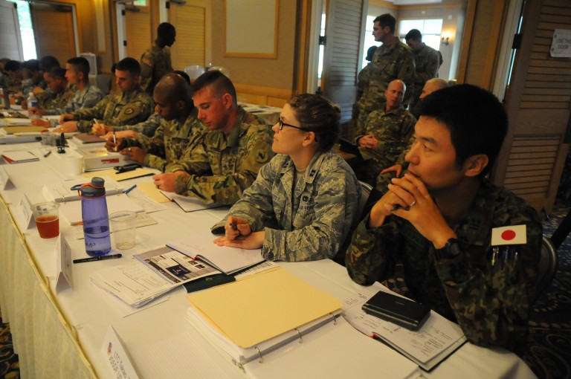
CURRENT AND FUTURE ARMY LEADERS NEED TO BE ABLE TO THINK STRATEGICALLY
• Army leaders need to anticipate change, think long term, envision potential futures, and exploit opportunities to serve national interests
• Before Army leaders step into positions that require them to function as strategic thinkers and planners, they need to hone the “building block” skills that underpin strategic thinking
Image credit: http://www.hawaiiarmyweekly.com/storage/2016/02/2378779-768x510.jpg

Slide 5
WHAT SKILLS ARE FOUNDATIONAL TO STRATEGIC THINKING ABILITY?
Competency | A Strategic Thinker…
Comprehensive Information Gathering | continuously scans the environment seeks information from disparate sources suspends judgment and maintains an open mind considers other perspectives possesses advanced listening and research skills
Learning | is a lifelong learner iteratively tests, reflects on, conceptualizes, and manages knowledge to gain insights on the environment continuously examines his/her own thinking
Critical Thinking | identifies the essential aspects of a situation questions assumptions and asks relevant questions seeks to identify meaningful connections and distinctions understands nuance considers the limits of data

Slide 6
WHAT SKILLS ARE FOUNDATIONAL TO STRATEGIC THINKING ABILITY? (CONT’D.)
Competency | A Strategic Thinker…
Thinking in Time | understands historical and contemporary contexts. recognizes patterns. forecasts possible futures. anticipates second-and third-order effects. has a long-term perspective.
Innovative Thinking | generates creative and novel ideas, concepts, and approaches, independent of conventional norms.
Systems Thinking | uses a holistic perspective of the dynamic and complex environment. identifies interrelationships and integrates disparate factors into a comprehensive whole.

Slide 7
WHAT ELSE IS IMPORTANT TO STRATEGIC THINKING ABILITY?
Competency | A Strategic Thinker…
Knowledge | Has a solid foundation for strategic thinking based in: a broad general knowledge of many disciplines (e.g., geo-politics, world religions/cultures, economics, technology, sociology). knowledge specific to a strategic environment (e.g., local/regional customs, history, stakeholders).
Collaboration | Leverages the capabilities of others in a team or informal network (e.g., through cooperation, leadership, building trust, conflict management) to supplement his/her own strategic thinking.
Communication | Communicates candidly and effectively to gain individual understanding and move to the shared understanding required for strategy implementation. Is adept in the use of multiple media formats (oral, written, visual). Communicates well with diverse audiences that require tailored and persuasive messages.
Emotional Regulation | Is intellectually humble. Accounts for his/her own natural limitations and biases related to emotion, perspective, and self-interest. Maintains respect for differing values and priorities.

Slide 8
STRATEGIC THINKING SKILL-BUILDING EXERCISES WILL HELP YOU BUILD SKILLS NEEDED FOR STRATEGIC THINKING.
Exercises in this series include:
Reflecting on Experience--provides practice in reflective thinking, learning from experience.
Asking Powerful Questions--provides practice in questioning.
Telling a Story--provides practice in systems thinking, synthesis.
Envisioning Potential Futures–-provides practice in thinking in time, strategic foresight.

Slide 9

THINK OF THESE EXERCISES AS COMPARABLE TO AN ATHLETIC DRILL.
Professional basketball players don’t just play a lot of basketball.
They practice component skills –ball handling, shooting baskets, rebounding, and footwork.
Practicing these foundational skills –repeatedly and over time –is essential to becoming a skilled basketball player.
Image credit: shutterstock.com
Notes:
One way to think about these exercises is akin to what young athletes experience on their way to becoming exceptional athletes. A basketball player practices component skills such as dribbling, shooting, rebounding, passing, and footwork. Practicing these component skills – and doing so repeatedly and over time – is essential to becoming a skilled basketball player.

Slide 10
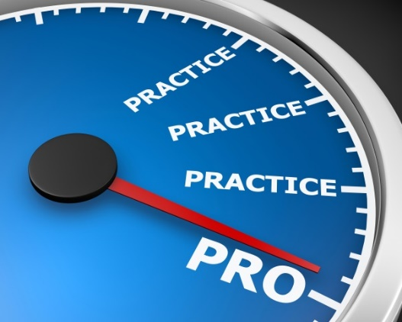
DEVELOPING STRATEGIC THINKING ABILITY ALSO REQUIRES TIME, PRACTICE, AND ATTENTION TO FOUNDATIONAL SKILLS.
Doing any of the exercises once or twice will not transform you into a strategic thinker.
They are analogous to the drills that athletes use to hone their skills.
Developing advanced ST skills means repeatedly practicing the foundational skills necessary to become a great strategic thinker.
The exercises can help you practice some of the (many) skills you’ll need in order to become a skilled strategic thinker.
Image credit: shutterstock.com
Notes:
In the same way, practicing skills such as reflecting, questioning, systems thinking, and thinking into the future (and doing so repeatedly) is essential to becoming a skilled strategic thinker.
Doing any of the exercises once or twice will not transform you into a strategic thinker.
They are analogous to the drills that athletes use to hone their skills.
Developing advanced strategic thinking skills means repeatedly practicing the foundational skills necessary to become a great strategic thinker.
The exercises can help you practice some of the (many) skills you’ll need in order to become a skilled strategic thinker.

Slide 11
Overview
Envisioning Potential Futures

Slide 12
WHAT’S THE PURPOSE OF THIS EXERCISE?
Primary Purpose: To build your strategic foresight skills.
  Strategic Foresight – Generating concepts of possible future alternatives based on attention to a diverse range of factors and their interactions.
  Thinking in Time – Alternating between thinking about the past, present, and future.
Secondary Purpose: To practice ways of shaping the future in the context of a scenario.
Image credit: shutterstock.com
Notes:
What we’re doing today is a drill to help you practice thinking in time and strategic foresight – two (of the many) skills you’ll need to become a powerful strategic thinker.
Strategic foresight involves thinking across time – i.e., considering current and historical circumstances and envisioning potential future scenarios based on attention to military, economic, socio-cultural, technological, and political trends and interactions.
Envisioning potential futures is essential for strategic thinking. It supports our ability to develop understanding of current and past circumstances, and conceptualize possible strategies and initiatives we might pursue to shape the future. This, in turn, allows us to set priorities and effectively allocate resources.

Slide 13
THE EXERCISE WILL ALSO HELP YOU PRACTICE THESE ADDITIONAL SKILLS:
Questioning – An active learning strategy used to understand problems, relevant factors, interdependencies, assumptions, and differing perspectives more deeply.
Systems Thinking – Recognizing and describing relationships and interdependencies among factors that might otherwise appear unrelated.
Visualizing – Creating and thinking in mental images.
Sensegiving – Communicating your understanding to others.

Slide 14
WHAT WILL I DO IN THE EXERCISE?
Read a brief description of an emerging global “hot spot”
Sketch your understanding of the problem, considering a range of factors
Think back in time 5 years and describe conditions that existed then
Think forward in time and describe alternative futures
Consider possible courses of action to shape the future
Reflect on the exercise and discuss with the group

Slide 15

WHAT MATERIALS DO I NEED?
Participant Guide (provided by facilitator)
Pen/pencil
Notebook/pad of paper
Image credit: shutterstock.com

Slide 16
WHAT WILL I GAIN FROM THIS EXERCISE?
Appreciate the value of expanding your thinking beyond the present and/or near-term future.
Recognize that current assumptions, decisions, and courses of action can have long-term implications.
Recognize that thinking back in time (historically) can support your ability to anticipate how the situation may evolve into the future.
Consider a range of factors (e.g., military, political, socio-cultural, religious, economic, physical environment, technological) and their interactions when making sense of a situation and anticipating potential futures.
Create and present descriptions of potential futures.
Notes:
By the end of the exercise, you should be able to:
Appreciate the value of expanding one’s thinking beyond the present and/or near-term future.
Recognize that current assumptions, decisions, and courses of action can have long-term implications.
Recognize that thinking back in time (historically) can support one’s ability to anticipate how the situation may evolve into the future.
Consider a range of factors (e.g., military, political, socio-cultural, religious, economic, physical environment, technological) and their interactions when making sense of a current situation and anticipating potential futures.
Create and present descriptions of potential futures.

Slide 17
Brief Tutorial

Slide 18
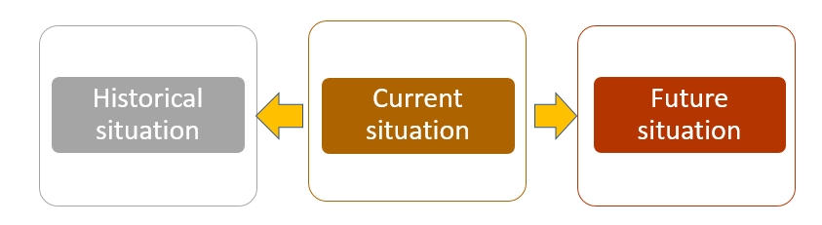
WHY DOES FORESIGHT MATTER?
Foresight is a key building block to developing strategic thinking skills.
Involves thinking about how a situation might evolve into the future
Requires attention to multiple factors -- social, economic, political, military, environmental, and technological trends and interactions.
Allows us to generate approaches to shape the future.
Enables us to set priorities and allocate resources.
Notes:
Foresight (or thinking in time) is an important component of strategic thinking
It involves considering current and historical circumstances and envisioning potential future conditions based on attention to social, economic, political, military, environmental, and technological trends and interactions.
Strategic foresight supports our ability to determine possible strategies and initiatives we might pursue to shape how a set of conditions evolves into the future.
This, in turn, enables us to set priorities and allocate resources.

Slide 19
WHAT’S HARD?
Factors that may hinder foresight
Army leaders typically face a host of immediate problems and the need to “put out fires.”
  Focus on current and near-term problems can crowd out consideration of the longer-term future.
Anticipating potential future scenarios means dealing with complexity.
  Requires thinking holistically about multiple factors and how they might interact to affect future events.
  Can be challenging to break silos.
Notes:
Many factors pose barriers to effective foresight. For example:
Army leaders may find they are constantly “putting out fires” or dealing with immediate problems. Focusing heavily on the present and near-term future can leave less mental space to think about the long-term future.
The ability to anticipate potential future scenarios requires the ability to think holistically and to consider multiple factors – such as political, military, environmental, economic, socio-cultural, technological, and other factors – and how they might interact to affect future events. Though we have a framework to help us consider multiple factors (PMESEII-PT), it is often a challenge to “break the silos” and make connections across those factors.

Slide 20
WHAT’S HARD?
Factors that may hinder foresight (Cont’d.)
The range of information resources we use to identify patterns and trends is often limited.
  May lead to an incomplete picture.
  May miss key trends and form incorrect interpretations.
We tend to be overly optimistic in our predictions about future situations.
We tend to focus on what is happening now and project that forward—rather than imagining the wild card/unexpected disruption that could change everything.
Notes:
We tend to refer to a limited number of information and personal sources to identify patterns and trends. This narrow focus can lead us to miss key trends and form incorrect interpretations.
We tend to be overly optimistic in our predictions about future situations, particularly when we are personally involved in those situations.
We tend to predict the future by assessing only what is currently occurring, rather than imagining a “wild card” or disruption that changes everything.

Slide 21

TIPS AND STRATEGIES FOR ENGAGING IN
STRATEGIC FORESIGHT
Think backward in time in order to think into the future:
Think about futures that are possible, not just the future that seems most obvious.
Recognize that what matters most in the present, or what mattered most in the past, may not be what matters so much in future events.
Image credit: shutterstock.com
Notes:
Some tips and strategies for engaging in strategic foresight include the following:
Think twice as far backward in time as you want to think forward. For example, think back in time 10 years to think forward 5. This will help you identify trends, trajectories, gaps and discontinuities, and the requirements and impacts of time. Recognize that doing this may require comprehensive information gathering.
Consider not only futures that are probable (i.e., likely) but also futures that are possible and perhaps less likely.
Recognize that what matters most in the present, and what mattered in the past, may not matter so much in future events. If it doesn’t, what might?

Slide 22
TIPS AND STRATEGIES FOR ENGAGING IN STRATEGIC FORESIGHT (Cont’d.)
Recognize that whatever you come up with, you are likely to be off base.
Go wide in your information search:
  Consult a wide variety of sources--e.g., people of diverse backgrounds, varied publications, websites.
  Gather information about a range of topic areas--e.g., politics, economics, technology, social issues, etc.
  Consider the perspectives of the sources you are using.
Notes:
Recognize that whatever you come up with, you are likely to be off base.
The point isn’t to figure out the right answer, but to appreciate a given situation more fully so you can effectively consider how it might evolve into the future.
Consult a wide variety of information sources (e.g., people of diverse backgrounds, diverse publications, people within your team who have different experiences) to gather information about current events, patterns, and trends in a range of areas (e.g., politics, economics, technology, social issue
Consider the perspectives of the sources you are using and how those perspectives might contribute to the information provided and the conclusions drawn.

